Slide 1
Through Your Own Lens®
Living Unapologetically
May 17, 2021
© 2021 Amy Steindler, Ovation Coaching, LLC. Through Your Own Lens® is a registered trademark of Ovation Coaching, LLC.

Slide 2
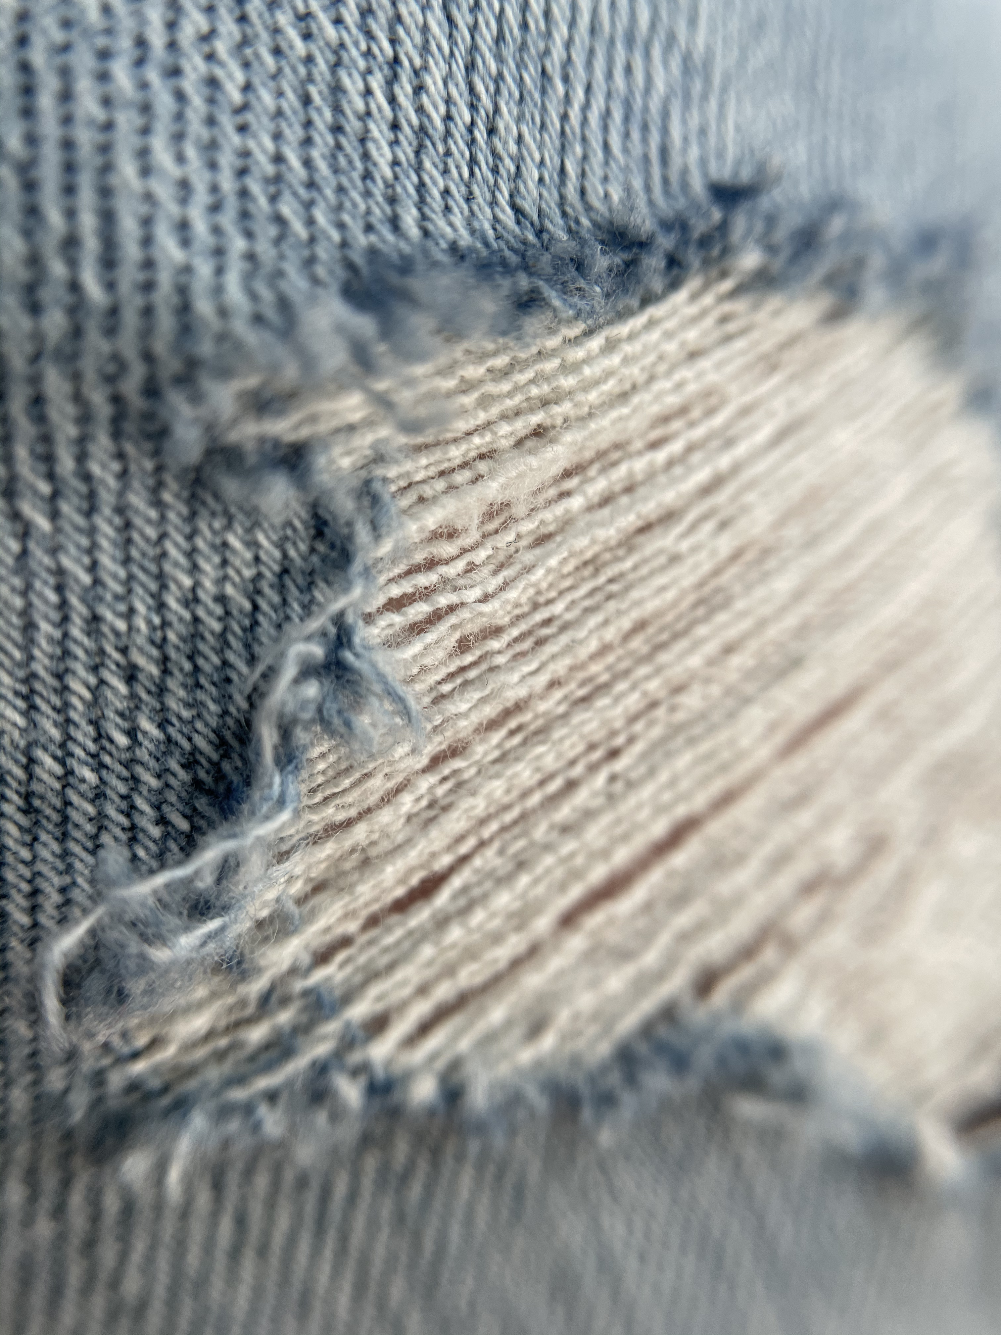

Wendy

Slide 3
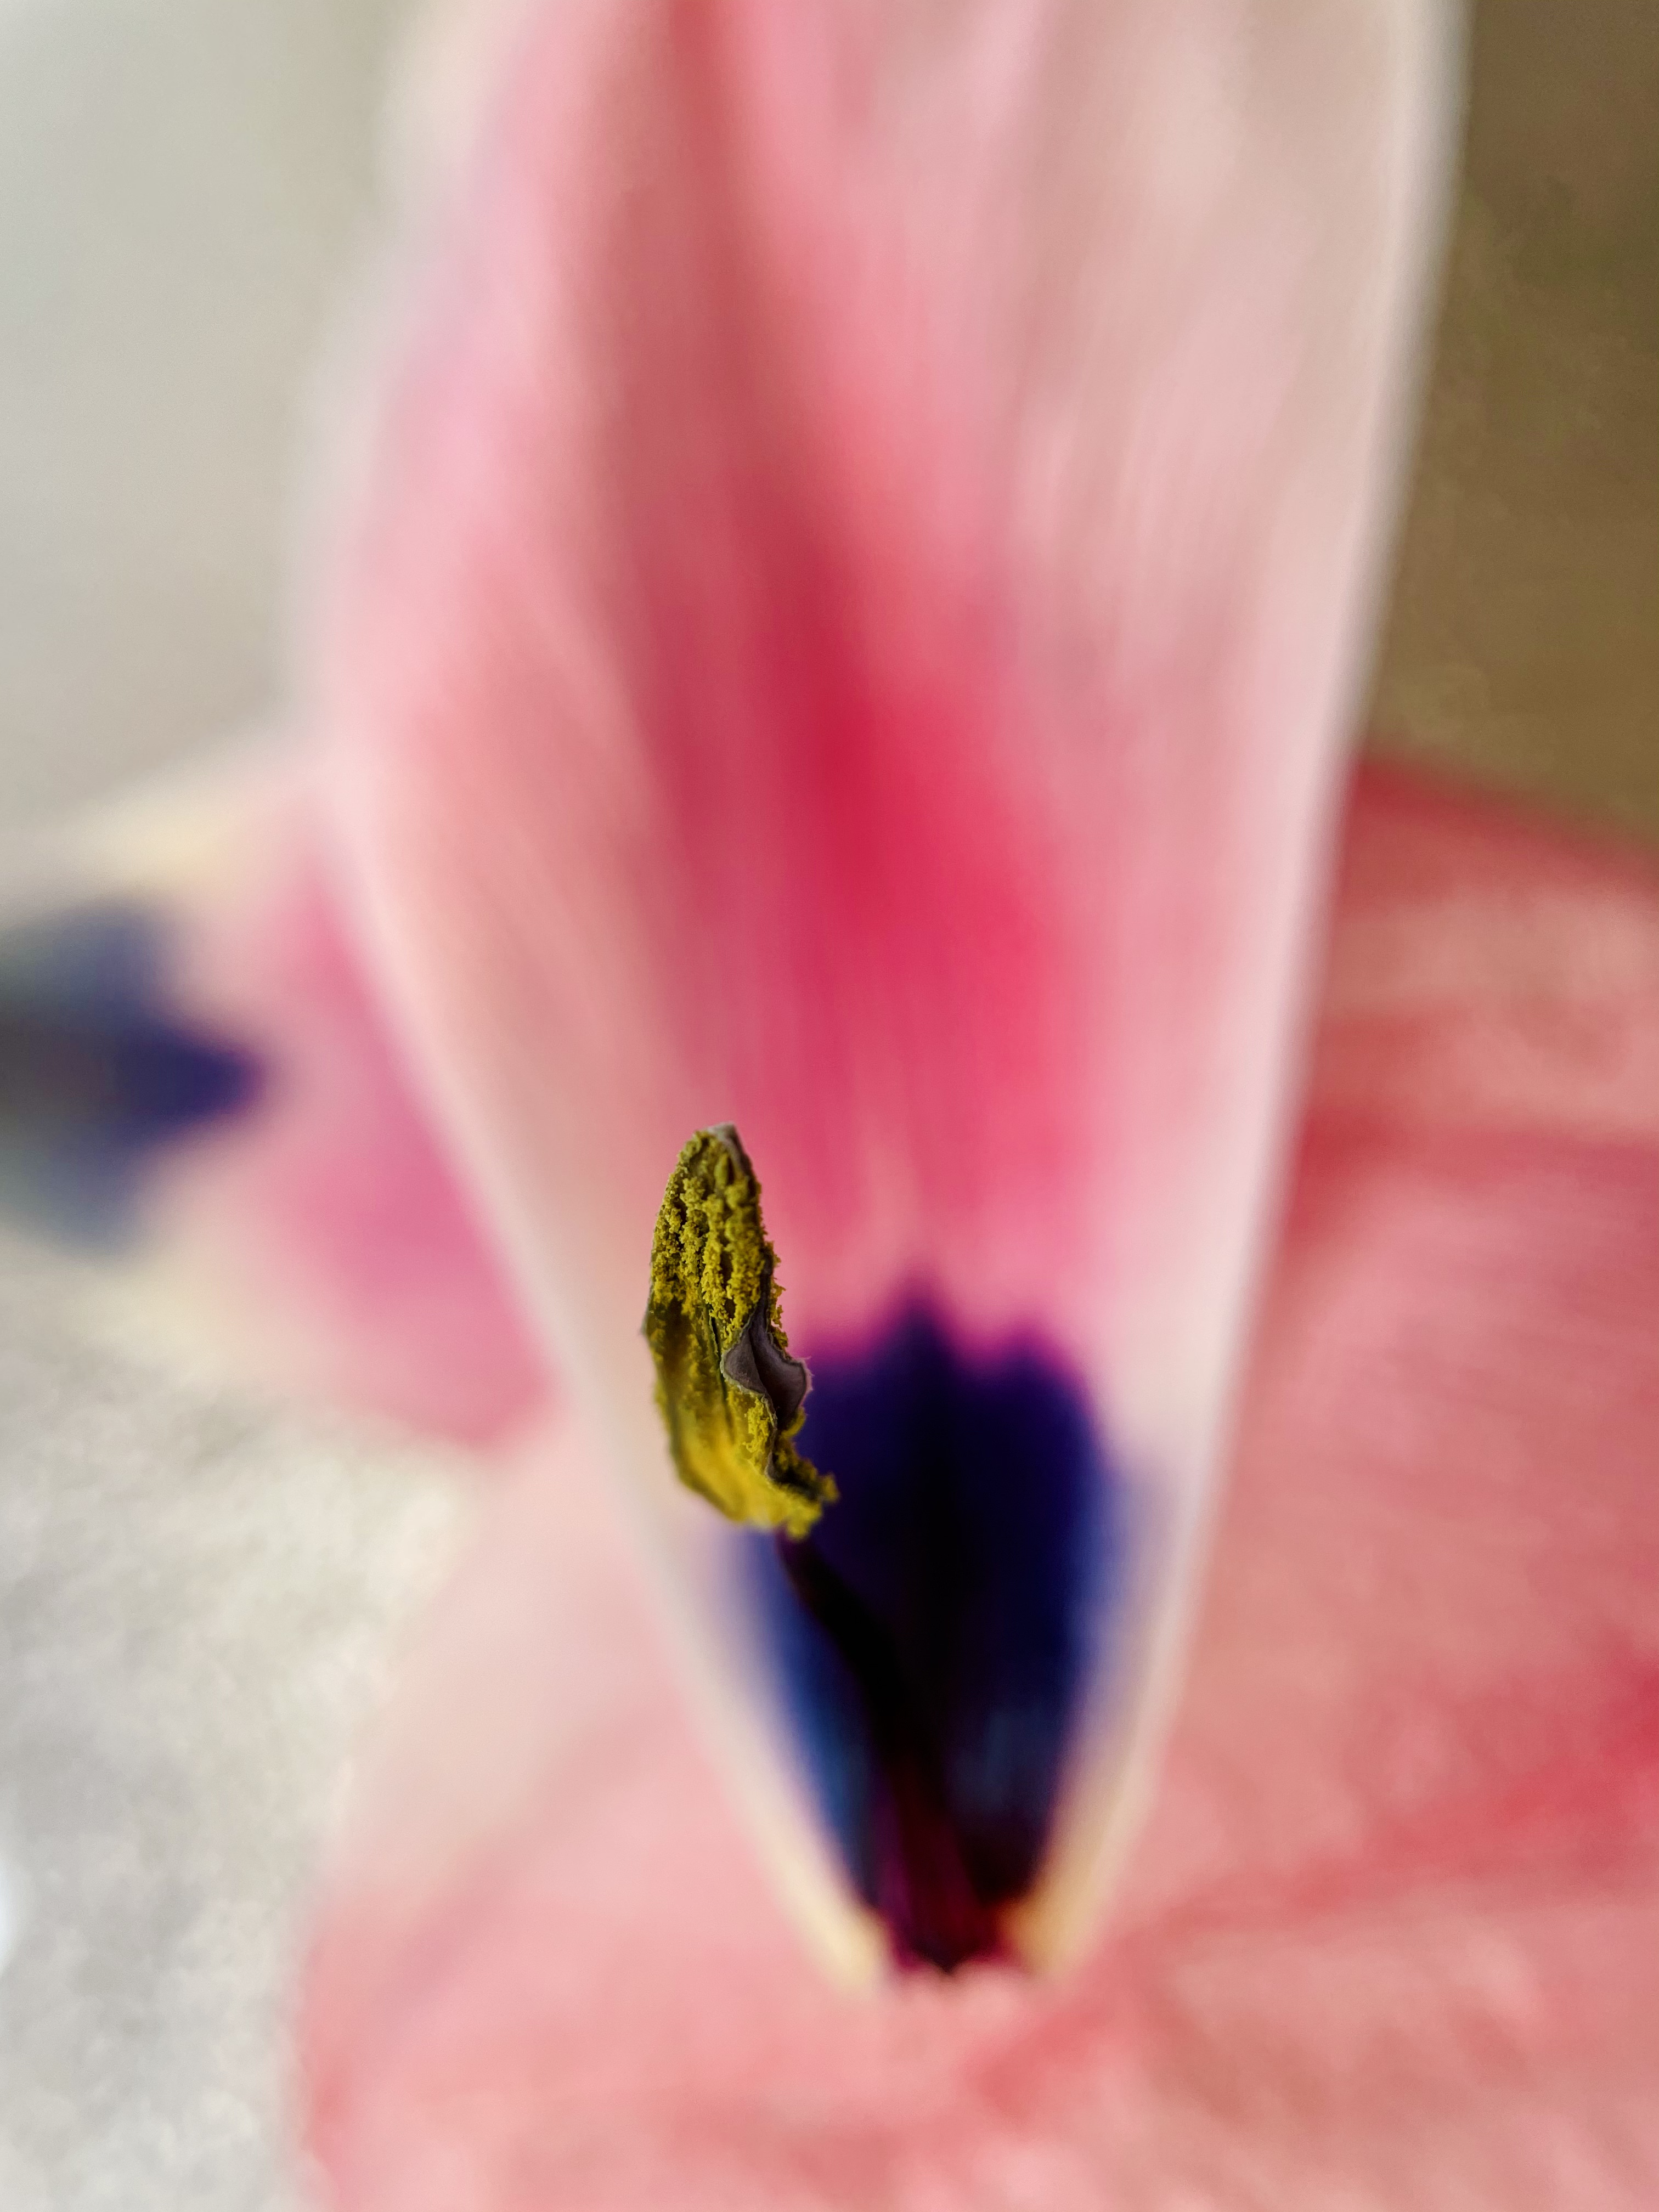
Wendy

Slide 4
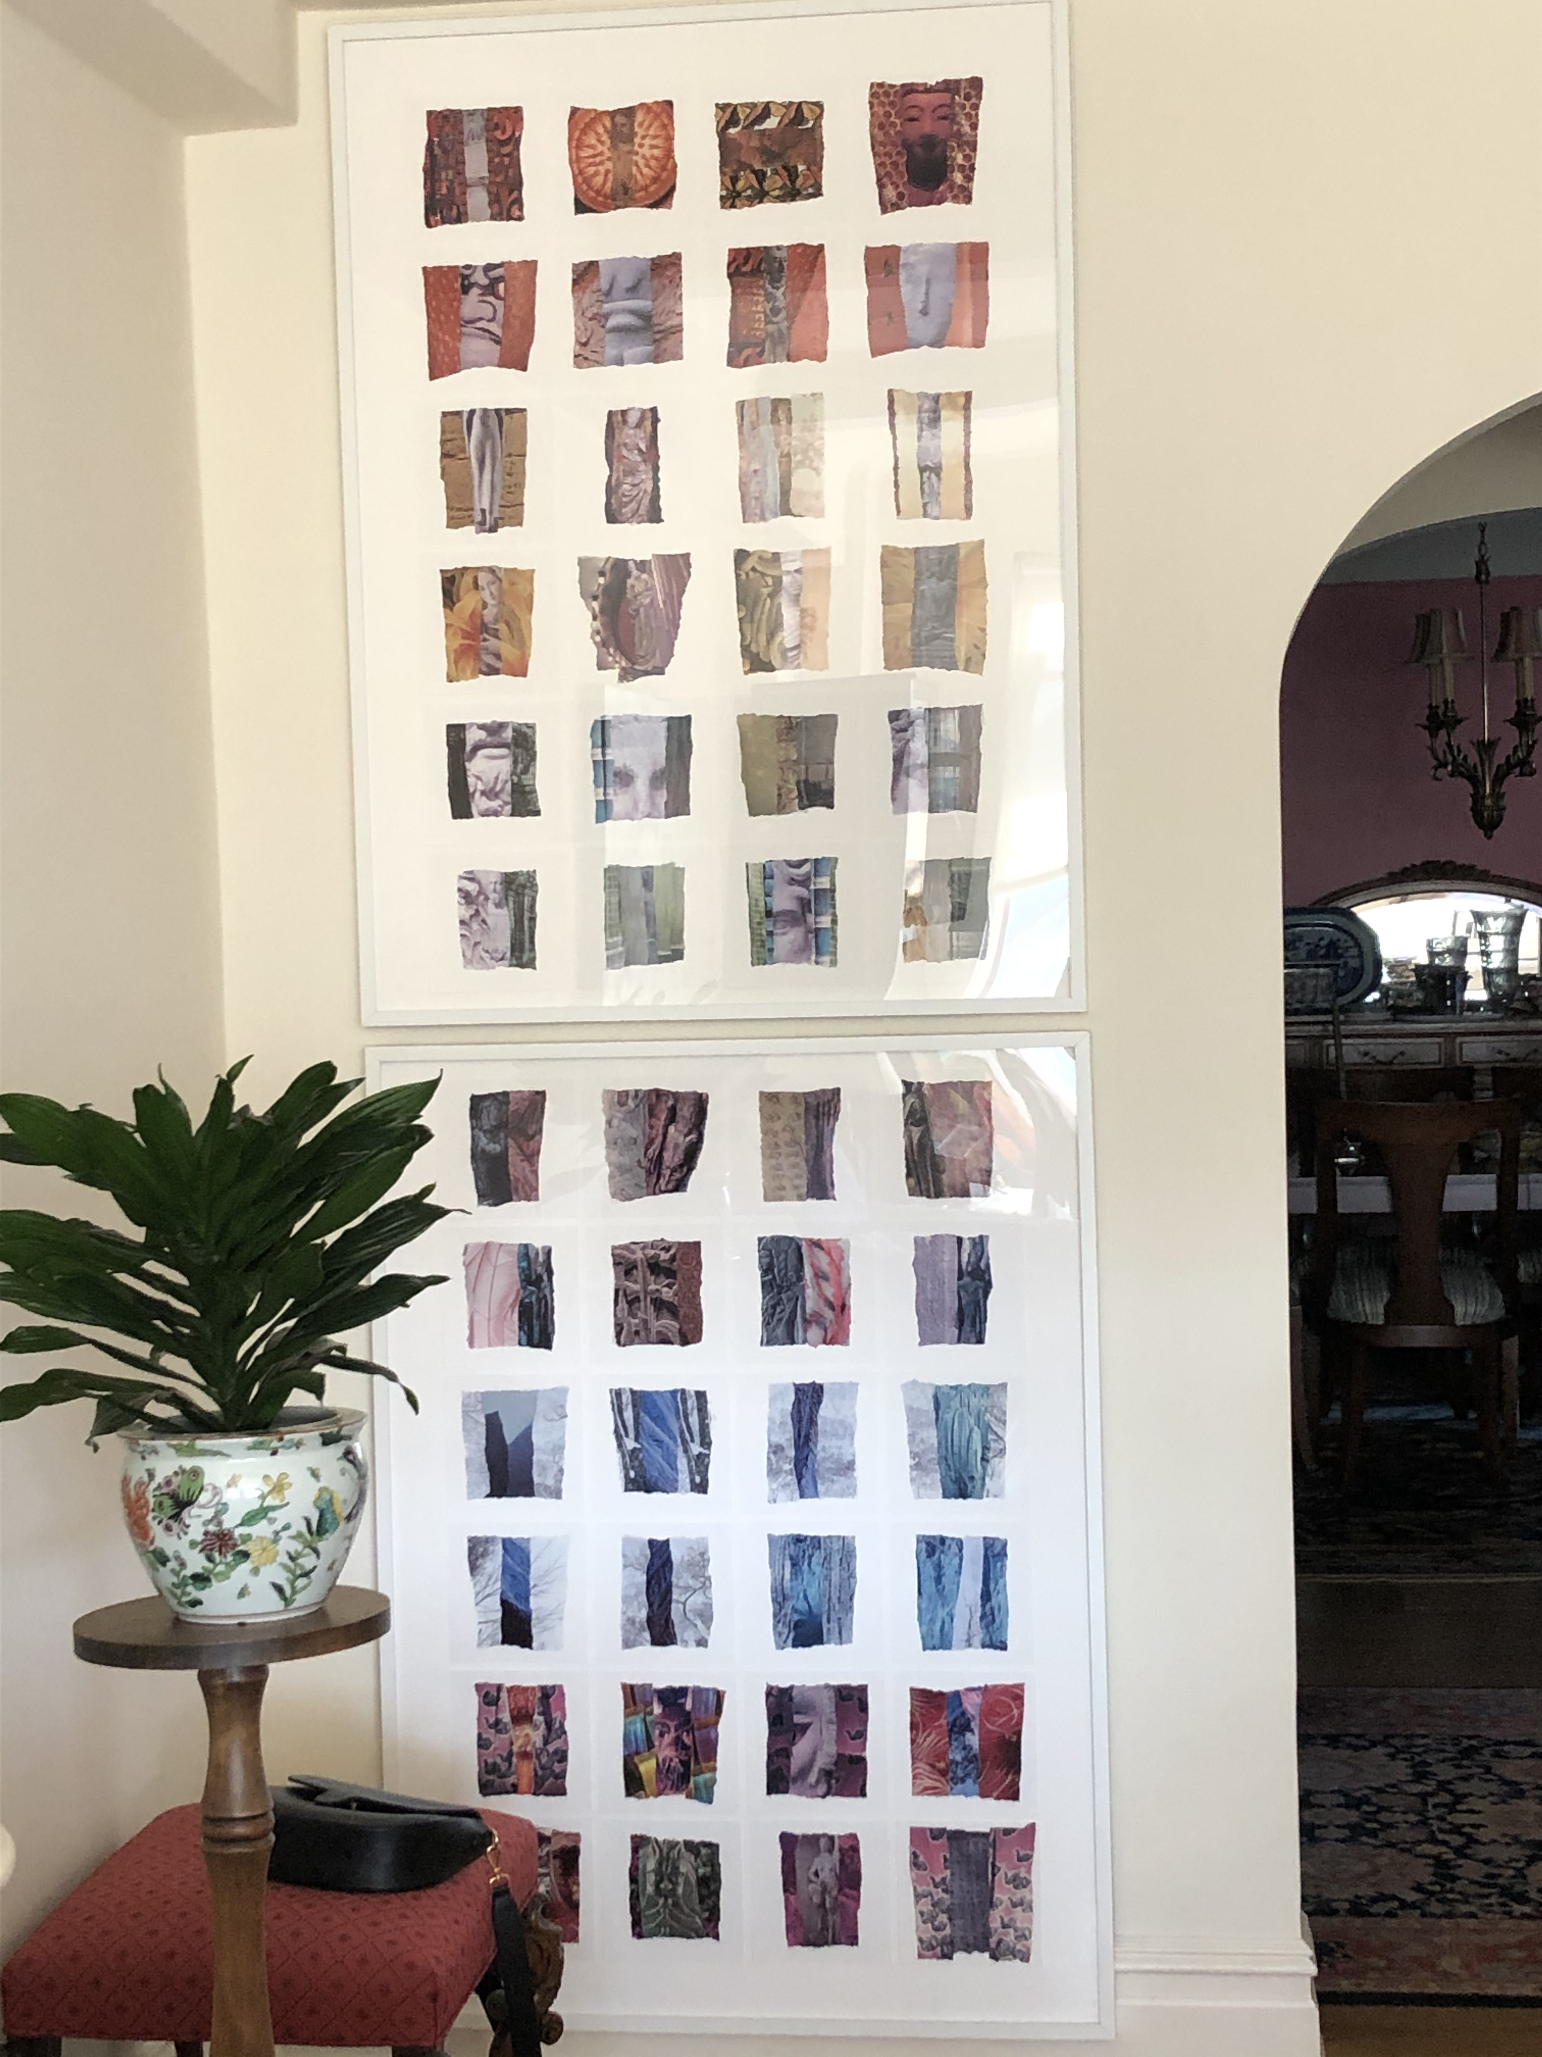
Fran

Slide 5
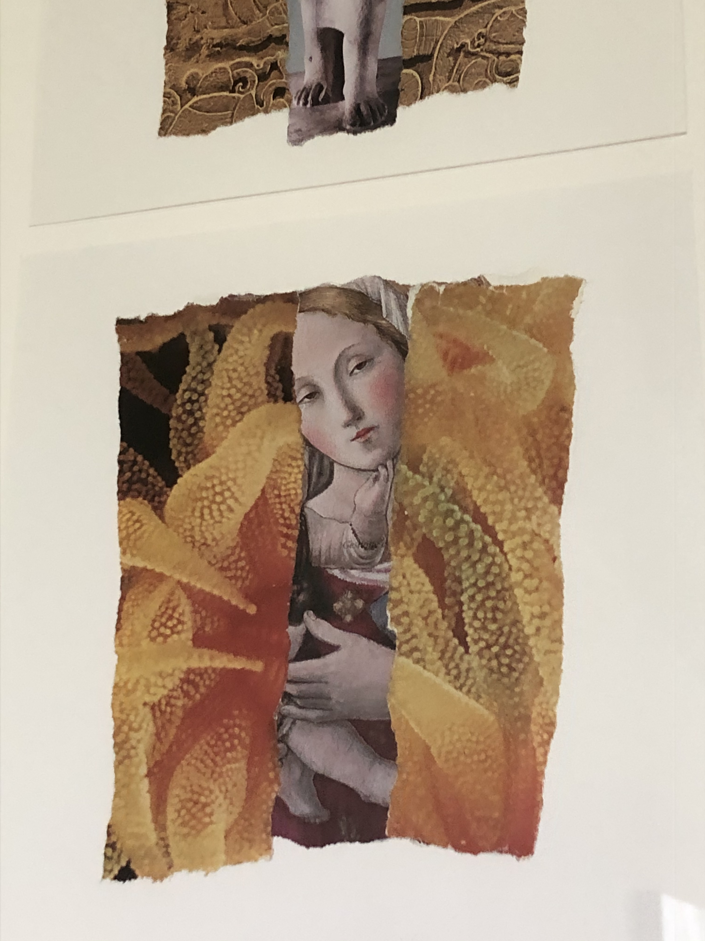
Fran

Slide 6

Fran

Slide 7
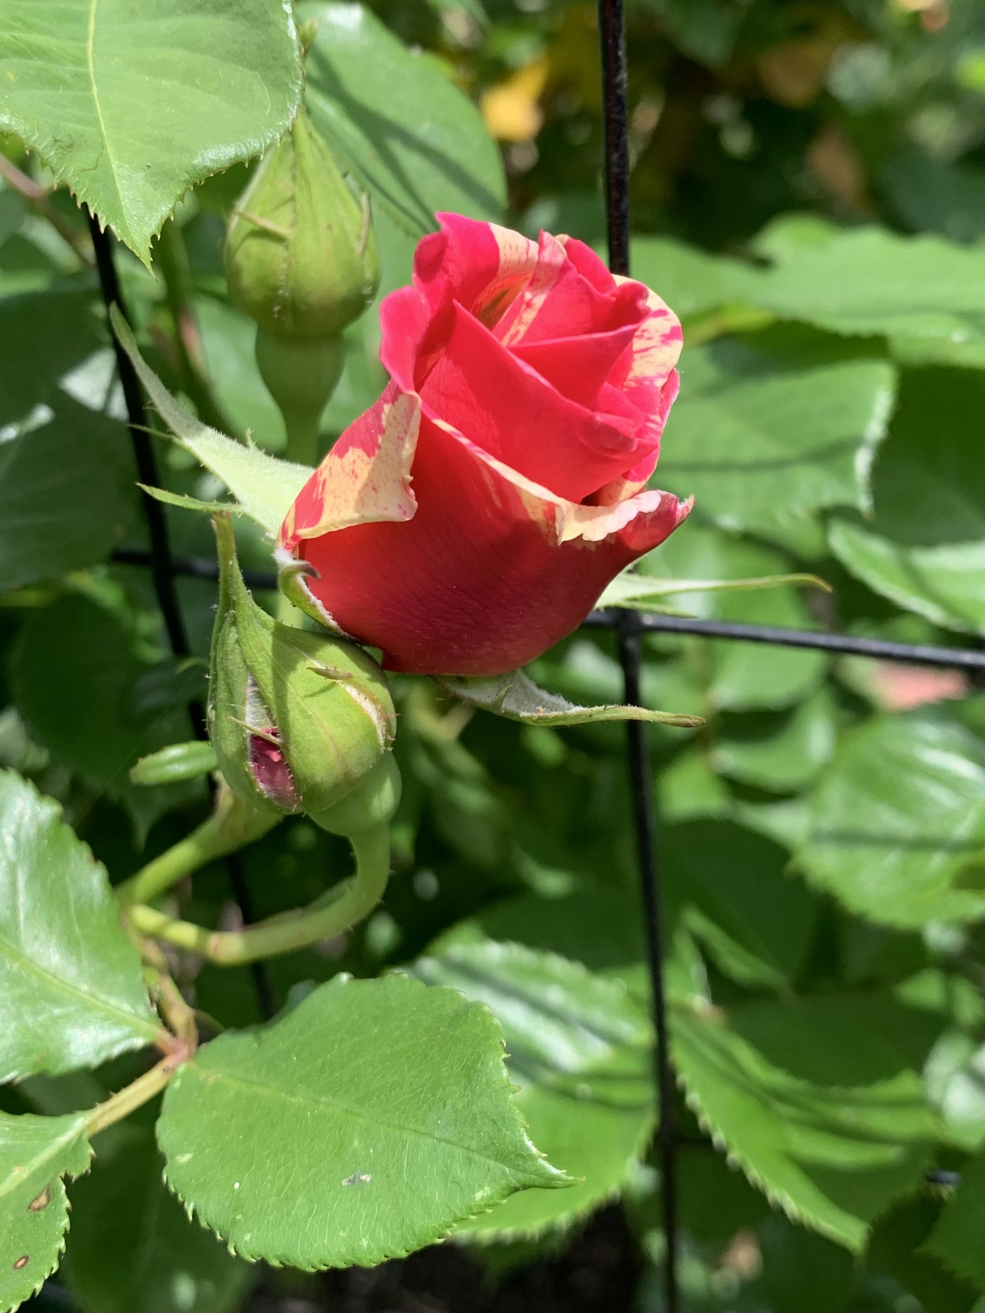
Kate

Slide 8
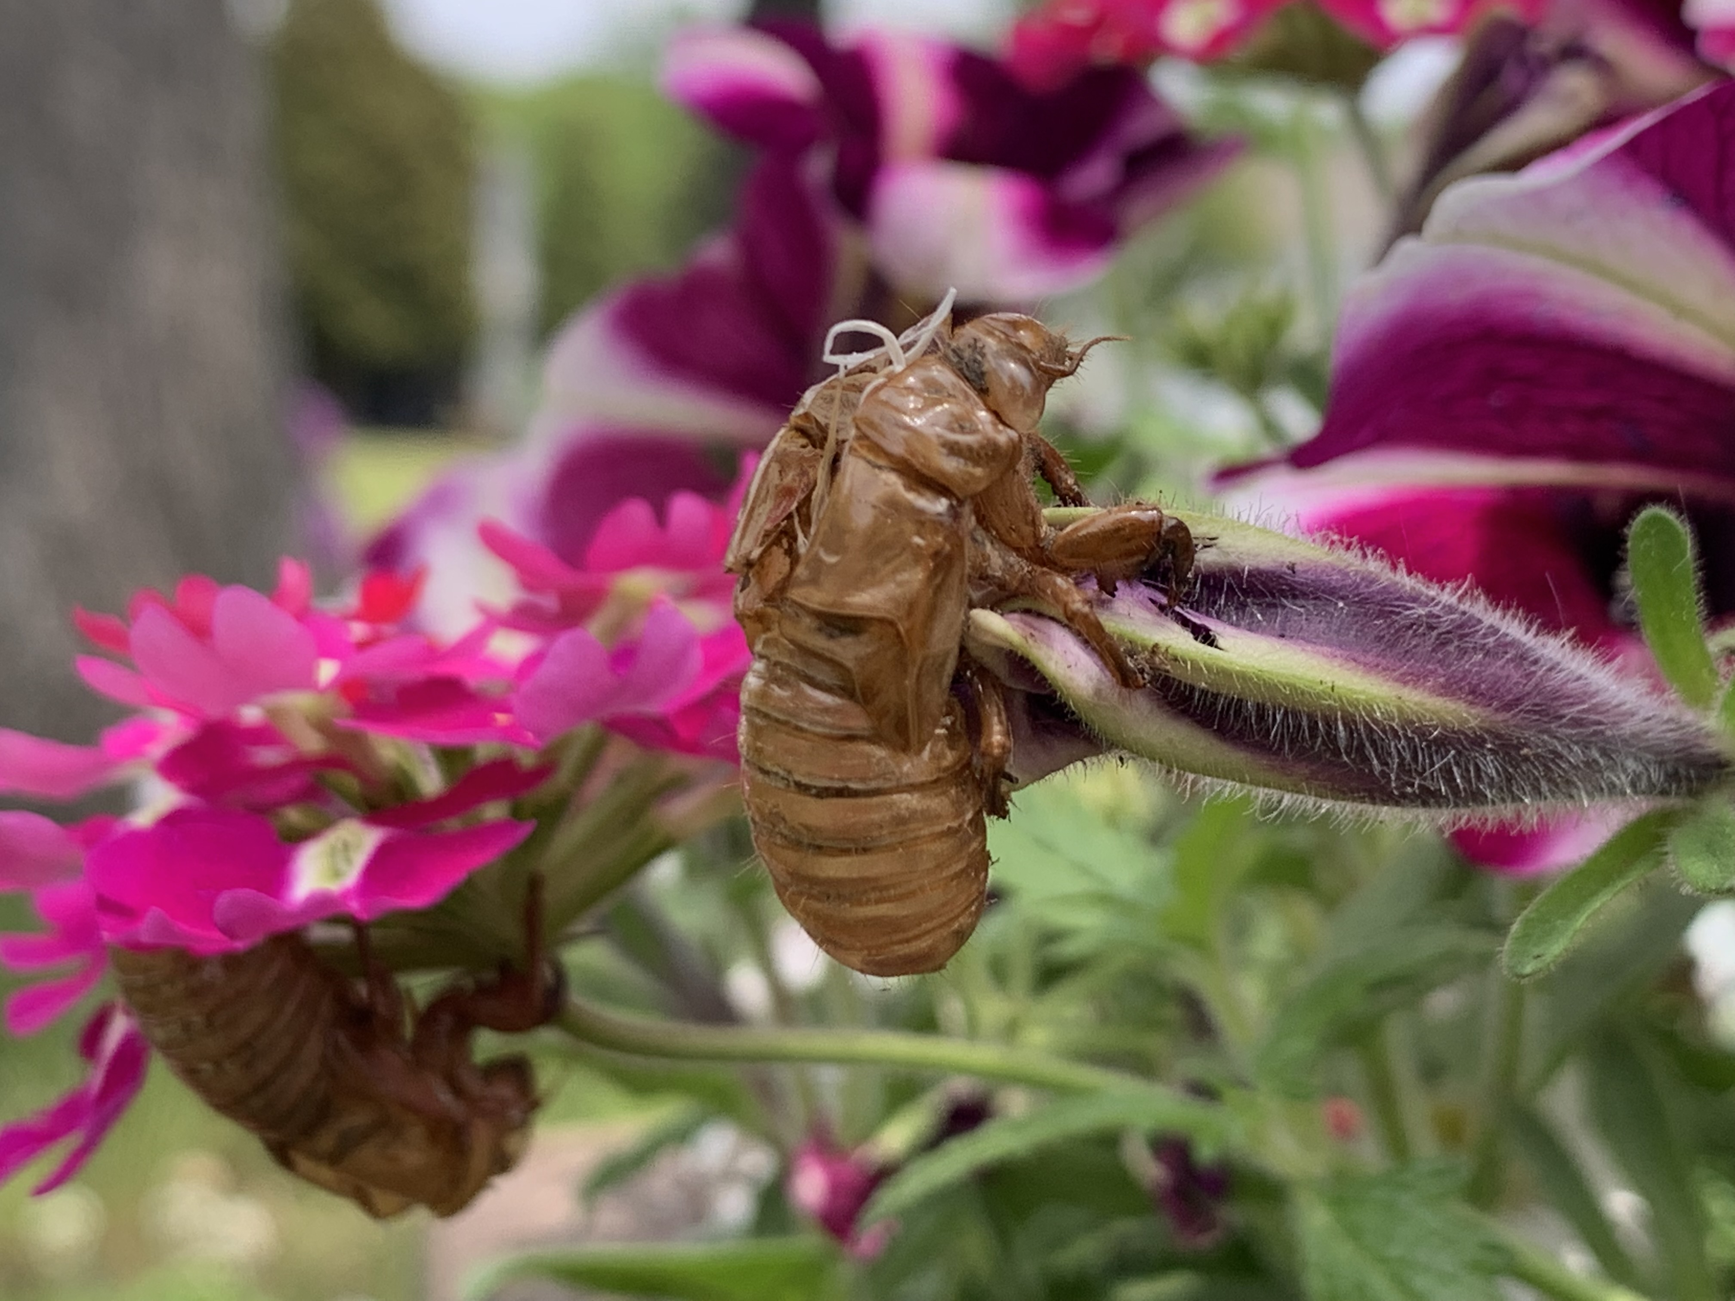
Kate

